Slide 1

Quant Week 6
10/23/25
Notes:
Complete

Slide 2


Spotlight

Slide 3
Ice Breaker
How were your exams?

Slide 4
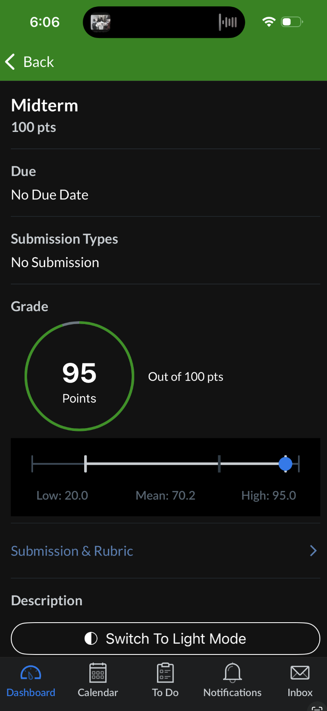

Slide 5
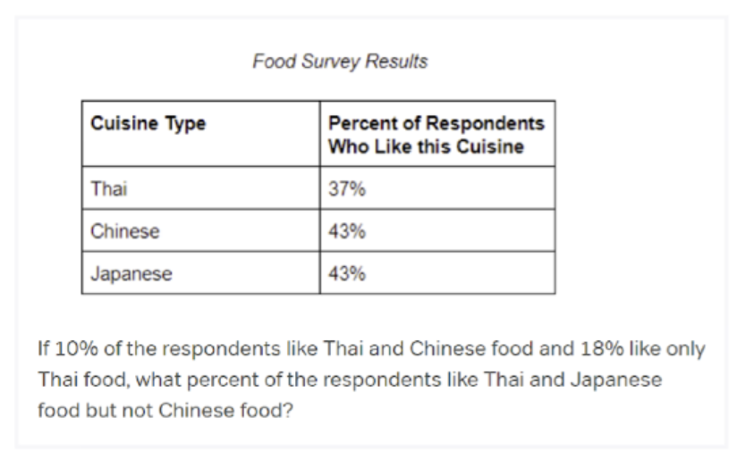
Brain Teaser

Slide 6
Weekly Sequence
7, 13, 12, 6, 8, 14, 11 ?
Notes:
6 -1 -6 2 6 -3 -6
5

Slide 7
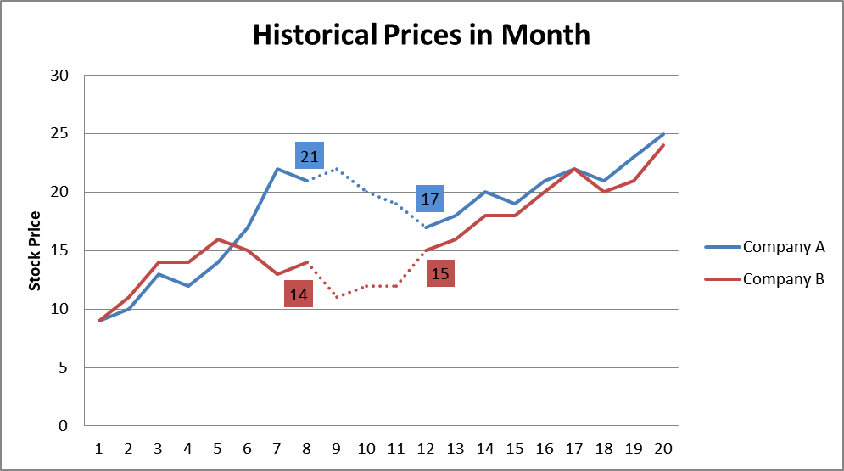
Some Trading Strategies
Pairs Trading
This strategy assumes that price changes in stocks in similar industries will tend to move together.
Holding all else equal, if Ford stock moves up, GM stock should move up as well
If Ford moves up and GM does not, it would be a good time to buy GM or short Ford.

Slide 8

Some Trading Strategies
RSI Index
RSI indicates if a stock is overbought or oversold.
It does this by keeping a moving average over a period of time of the average gain and average loss.
Values will be between 0 and 100, values over 70 indicate the stock is overbought and values under 30 indicate the stock is oversold.

Slide 9
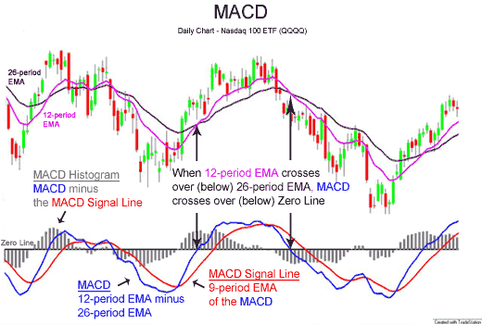
Some Trading Strategies
MACD
Moving Average Convergence/Divergence
This indicator graphs the moving average over two different time periods.
When the lines cross it shows changing strength/momentum and can indicate to buy or sell

Slide 10
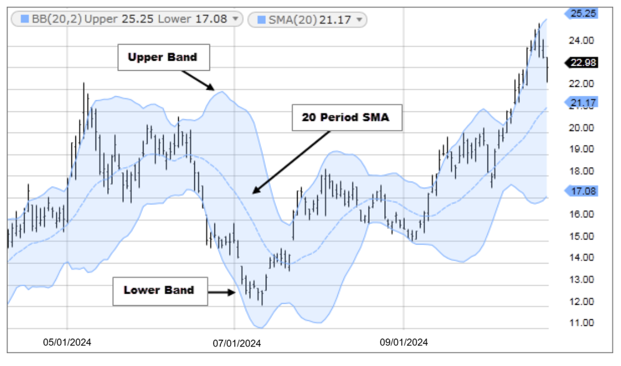
Some Trading Strategies
Bollinger Bands
Keep a moving average of the price of the stock.
The upper and lower bands are one standard deviation away from the current stock price.
If the price breaks through this level it indicates that the price is either high or low compared to the stock’s true value.

Slide 11
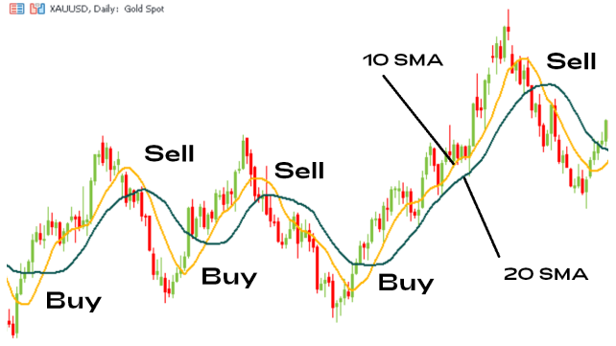
Some Trading Strategies
Swing Trading
Attempting to buy and sell within a short time period and take advantage of natural price fluctuations.
Subreddit r/swingtrading has 100k people talking about different ways to implement this

Slide 12
Project Discussion/Work Time
Notes:
Idea:
We’ll write the platform to make and conduct trading strategies.
You guys will write and implement the strategies, test them on prior data
Alternate for more software-oriented people you guys could also make the platform
We can do this in python/C++, if python use numPy and Yahoo Finance data
Use matplotlib plot graphs, show that in pdf/md/html file through github

